Slide 1




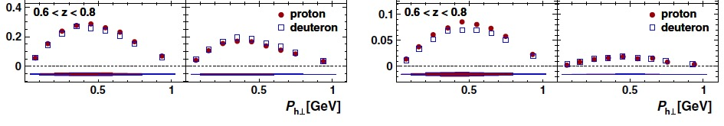
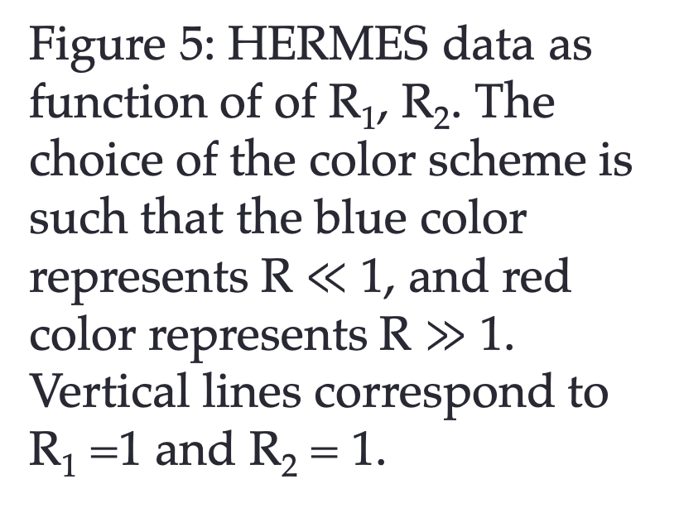

Collinearity criteria for transverse momentum dependent distributions in SIDIS: Study of the origin of Semi-Inclusive Deep Inelastic Scattering (SIDIS)
S. Dolan¹, L. Gamberg¹, A. Prokudin^{1,2}
¹ Division of Science, Penn State University Berks, Reading, PA
² Theory Center, Jefferson Lab, Newport News, VA
introduction
The SELECTION CRITERIA
DATA Analysis
Protons and neutrons (nucleons), which make up the nucleus of an atom, are not fundamental constituents of matter, but rather are themselves made up of particles called quarks. These quarks are “glued” together by the strong nuclear force, which is mediated by another particle called the gluon. Collectively quarks and gluons are called partons. Any particle containing quarks is called a hadron. Moreover, the quarks are not static inside of a nucleon – they have an intrinsic momentum even for a nucleon at rest. Understanding of the underlying structure of the nucleon in terms of quarks and gluons is one of the central goals of modern nuclear physics. Partons are not directly accessible by experiment, but rather experimental measurements are related by factorization theorems to functions that describe partonic structure of the nucleon.
One of the ways to access intrinsic motion is through a process called semi-inclusive deep inelastic scattering (SIDIS). In this reaction, a high-energy electron scatters off a quark inside of the nucleon. This quark forms a hadron in the final-state (e.g., a pion), which is detected along with the scattered electron (see Fig. 1).
In general, however, pions in this reaction are produced also from the remnants of the struck nucleon, or from gluons radiated in the process, see Fig. 2 and Ref. [1].
We can see that generically there are at least three regions of pion production in SIDIS. Each region has significant experimental and theoretical interest, and each is important for understanding of the nucleon structure. The demarcation of these regions is not exactly known and is needed for phenomenological extraction of the nucleon structure. Factorization theorems allow to relate each region to specific facets of nucleon structure. The purpose of this project is to identify the data that originates from Fig.1 ( Fig. 2 (a)) and allows to access intrinsic motion of quarks and gluons, also known as Transverse Momentum Dependent (TMD) structure. Fig. 3 depicts these regions as a function of pion rapidity and transverse momentum.
Recently, Ref. [2] introduced ratio criteria, R₀, R₁, R₂ for regions in SIDIS. Each ratio is a function of underlying parton kinematics. For instance, if all R₀, R₁, R₂ $≪$ 1, then the corresponding region of the data is the TMD region.
We implemented ratios R₀, R₁, R₂ and calculated values of ratios for each point of HERMES measurement. We found out, that the ratio R₀ is always smaller than 1 for the choice of partonic kinematics we used, i.e. the average parton mass and transverse momentum of order of 300 MeV. Ratios R₁, R₂ are presented in Fig. 5, where all HERMES data points are shown.
One can see that approximately 50% of HERMES data is such that R₁, R₂ < 1.
The size of Rs represents the size of errors associated with factorization, such that for large values of R, the errors become very big.
We also plot the data as function of P_{hT} in Fig. 6 in order to identify the appropriate region of transverse momenta for TMD description. As one can see from Fig. 6 the region of P_{hT} < 0.7 GeV can be associated with TMD physics.
Figure 5: HERMES data as function of of R₁, R₂. The choice of the color scheme is such that the blue color represents R $≪$ 1, and red color represents R $≫$ 1. Vertical lines correspond to R₁ =1 and R₂ = 1.
Figure 3: Sketch of kinematical regions of SIDIS in terms of the produced hadron’s Breit frame rapidity and transverse momentum. In each region, the type of suppression factors that give factorization are shown. From Ref.[2]
Figure 1: Schematic diagram of semi-inclusive deep inelastic scattering (SIDIS): a high-energy electron knocks a quark out of the nucleon. The quark forms a pion in the final state, which is detected along with the scattered electron.
Figure 6: All HERMES multiplicity data points as a function of P_{hT}. The color scheme is the same as in Fig. 5.
Figure 2: Lowest order SIDIS graphs corresponding to (a) the current region (b) the target region and (c) the central (soft) region. The faded zigzag lines represent non- perturbative and other interactions (e.g. hadronization) between the outgoing parton and the target jet. From Ref.[1]
The EXPERIMENTAL DATA
Conclusions and outlook
The data used in this analysis is from the HERMES Collaboration. The experiment scattered 27.6 GeV electrons on an unpolarized proton or deuteron target and detected either pions or kaons in the final state. Measurements were made of the hadron multiplicity, defined as the ratio of the SIDIS to the inclusive DIS cross sections for a particular target n and hadron h. HERMES collected data for 1 < Q² < 10 GeV², 0.023 < x_{B} < 0.6,
P_{hT} < 2 GeV, and 0.1 < z_{h} < 0.9. Some of the data is shown in Fig. 4.
We have shown that the ratio criteria, R₀, R₁, R₂, proposed in Ref. [2] can be successfully implemented for SIDIS data. Moreover, we have shown that the found region of applicability of TMD factorization is compatible with naïve expectations, namely, low P_{hT} region. We estimated that at least 50% of the data from HERMES measurements could be used in phenomenological analysis. In Fig. 6 we plot all available data grouping the data points in existing x_{B} bins and showing color lines to guide the eye that connect the points for representative z_{h} bins. One can observe that the characteristic bell curve shape of TMDs, and in particular the maximum of distributions belong to the TMD (current) region.
The next step step of our analysis will include a phenomenological fit of the data and extraction of underlying TMDs. We will also investigate the influence of the choice of underlying parton kinematics on the ratios and determination of TMD and other regions.
Acknowledgements
pion
kaon
We would like to acknowledge support from NSF under Contract No. PHY-1623454 and DOE under Contract No. DE-FG02-07ER41460.
Multiplicity
[1] M. Boglione, et al., Phys. Lett. B766, 245-253 (2017)
[2] M. Boglione, et al., e-Print: arXiv:1904.12882, (2019)
[3] A. Airapetian, et al., Phys. Rev. D87, 074029 (2013)
Figure 4: HERMES multiplicity data as a function of P_{hT}. Plots are from Ref. [3]

